Slide 1
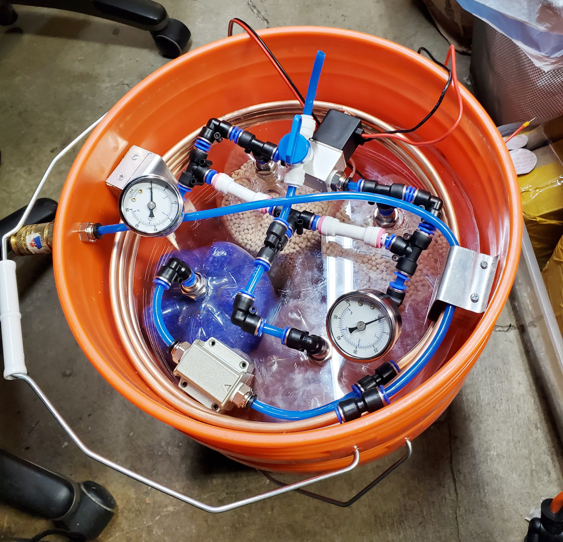
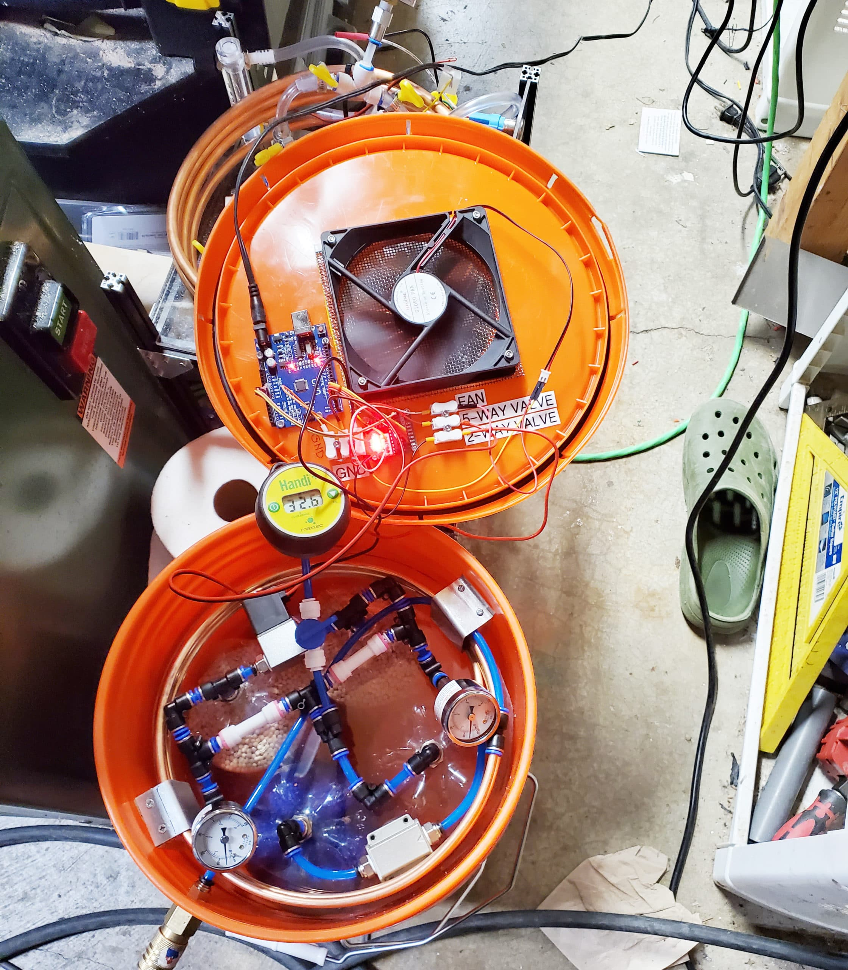
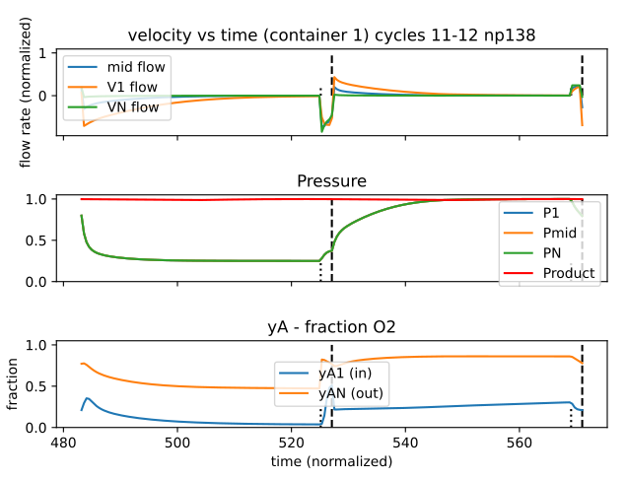
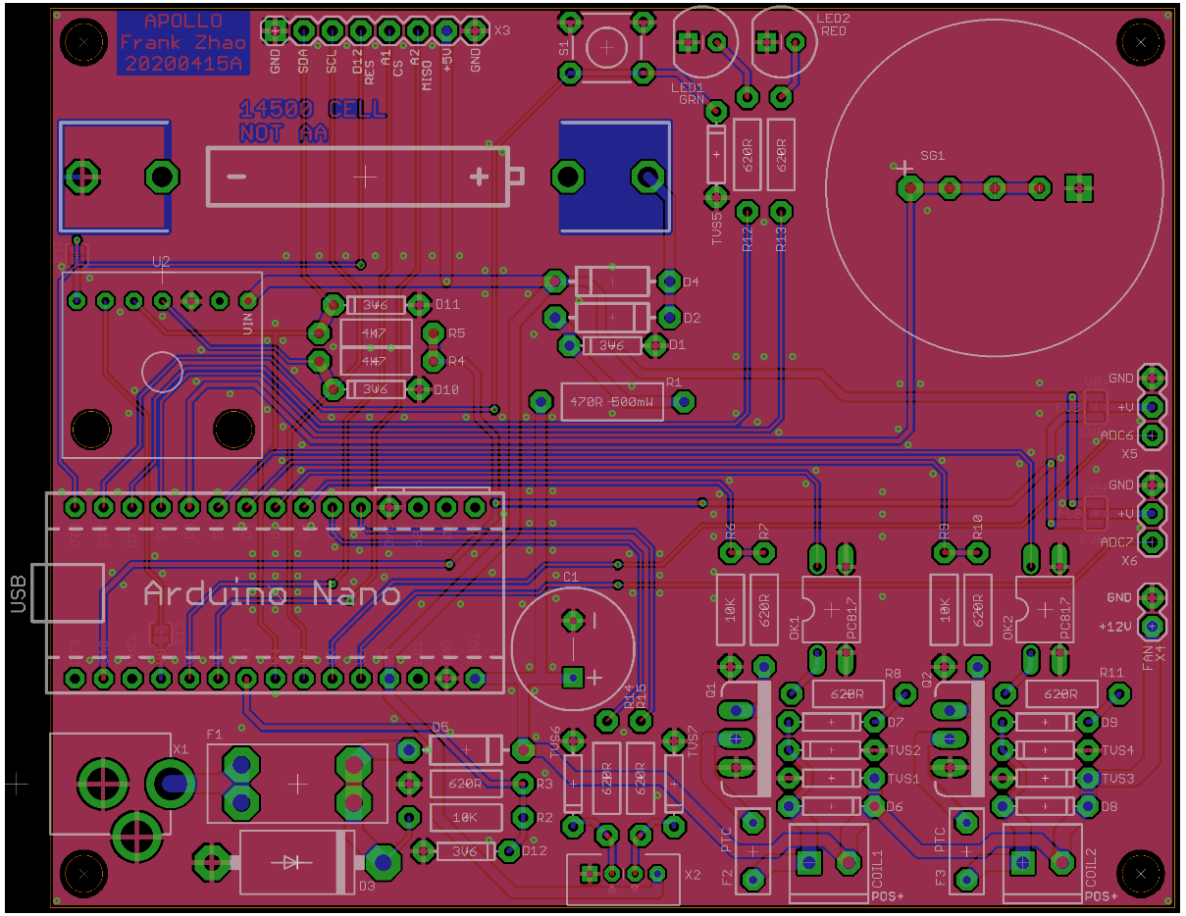
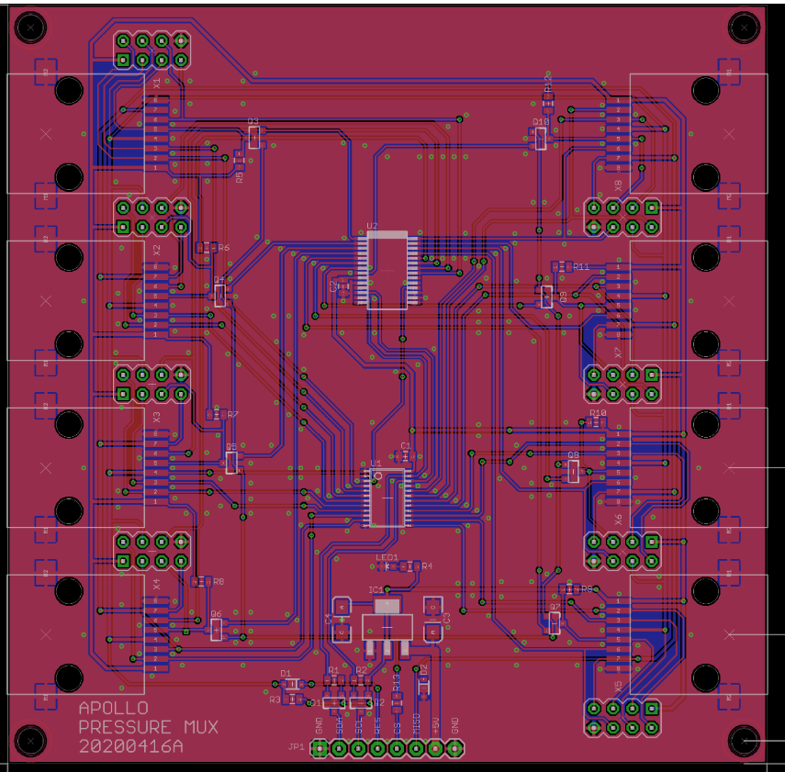
Project Apollo
Why
Ventilators need oxygen! (typical FiO2 0.3 … 1)
Oxygen generation is a big problem in developing countries.
No established infrastructure.
Oxygen bottles are expensive
People are already looking at alternative (local) ways for producing oxygen
What it is
Goal of the Apollo prototype = enabling people around the world to build the prototype as fast as possible
Focus = Simplicity and speed of build
Open source, off-the-shelf materials
Very low cost (aspirational target = $100 for 5 liters/min @ 90%)
Final goal = Enable people to iterate and publish their own designs in the community
How to build it
Follow the published build documentation
Buy/source the materials (check out the BOM)
Build the prototype
Validate O2 concentration and flow. Use a good reference O2 and flow sensor for calibration
Think about risk analysis and assessment: template for Apollo-derived design
Document and iterate your own design. Publish your findings to the community!
Collaborations
Peru, Afghanistan, Guatemala
Documentation
http://project-apollo.org
Already working on the next version
Focused on safety, user experience and maintainability
O2 compatible materials in the oxygen path
Dedicated PCB controller board, sensor integration, valve operational sensing
3” TFT touch screen for diagnostic messages, medical-grade buzzer
Auto-tuning (valve timing, auto-adjusts to changes in compressed air input pressure)

